Slide 1
Monopolistic Competition
Ravi Kiran

Slide 2
Monopolistic Competition
Monopolistic competition is a market structure in which many firms selling a differentiated product. Entry into and exit from the market is relatively easy.
Examples: Druggists stores, furniture, jewelry, leather goods, grocery stores, Petrol pumps, restaurants, clothing stores and medical care.

Slide 3
Characteristics of Monopolistic Competition
Relatively large number of sellers – firms have small market shares, collusion is unlikely and each firm can act independently
Differentiated products – the product is slightly different and is often promoted by heavy advertising
Selling Costs – Cost incurred to enhance the sales of the commodity
Easy entry to, and exit from, the industry – economies of scale are few, capital requirements are low but financial barriers exist

Slide 4
Differentiated Products
Product differentiation is a form of non-price competition in which a firm tries to distinguish its product or service from all competing ones on the basis of attributes such as design and quality.
The firms compete more on product differentiation than on price
Production differentiation entails product attributes, service, location, brand name and packaging, and some control over price.

Slide 5
Advertising
The goal of product differentiation and advertising is to make price less of a factor in consumer purchases and make product differences a greater factor.
The intent is to increase the demand for a product and to make demand less elastic.

Slide 8
Pricing and Output in Monopolistic Competition
The demand curve of a monopolistically competitive firm is highly, but not perfectly, elastic.
The price elasticity of demand for a monopolistic competitor depends on the number of rivals and the degree of product differentiation.
The larger the number of rival firms and the weaker the product differentiation, the greater the price elasticity of each firm’s demand.

Slide 9
Output, Price, and Profit of a Monopolistic Competitor
A monopolistically competitive firm prices in the same manner as a monopolist—where MC = MR.
But the monopolistic competitor is not only a monopolist but a competitor as well.

Slide 10
The Short Run: Profit or Loss
The monopolistically competitive firm maximizes profit or minimizes loss in the short run. It produces a quantity Q at which MR = MC and charges a price P based on its demand curve.
When P > ATC, the firm earns an economic profit.
When P < ATC, the firm incurs a loss.

Slide 11
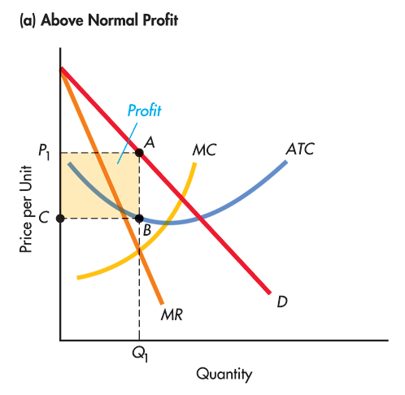
A Monopolistically Competitive Firm: Above Normal Profit

Slide 12
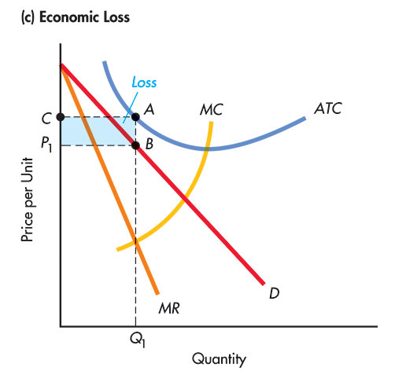
Economic Losses

Slide 13
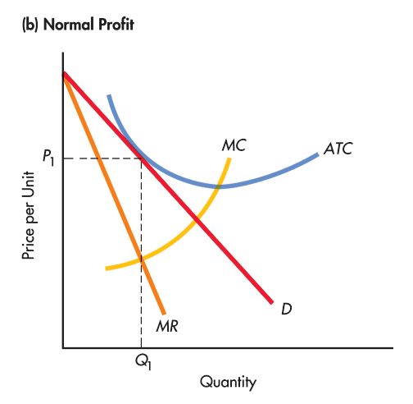
Normal Profits

Slide 14
The Long Run: Normal Profits
In the long-run, firms will enter a profitable monopolistically competitive industry and leave an unprofitable one.
A monopolistic competitor will earn only a normal profit and price just equals average total cost at the MR = MC output.

Slide 15
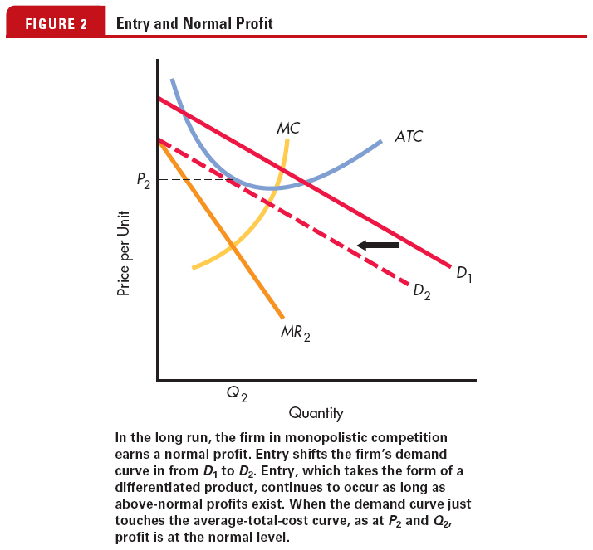
The Long Run: Normal Profit
Because entry to the industry is relatively easy, economic profits attract new rivals.
As new firms enter, the demand curve faced by the typical firm shifts to the left, reducing its economic profit.
When entry of new firms has reduced demand to the extent that the demand curve is tangent to the ATC curve at the profit-maximizing output, the firm is just making a normal profit, leaving no incentive for new firms to enter.

Slide 16
The Long Run: Normal Profit
When the industry suffers short-run losses, some firms will exit in the long run.
As firms exit, the demand curve of surviving firms begins to shift to the right, reducing losses until the firms are just making normal profit.

Slide 17
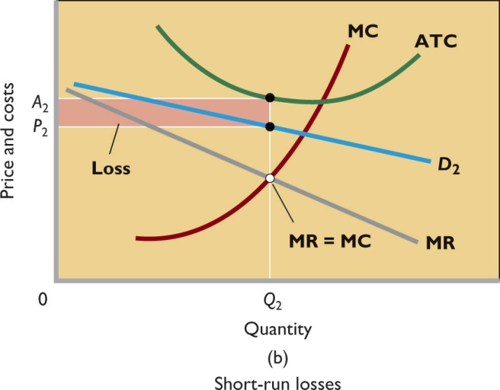
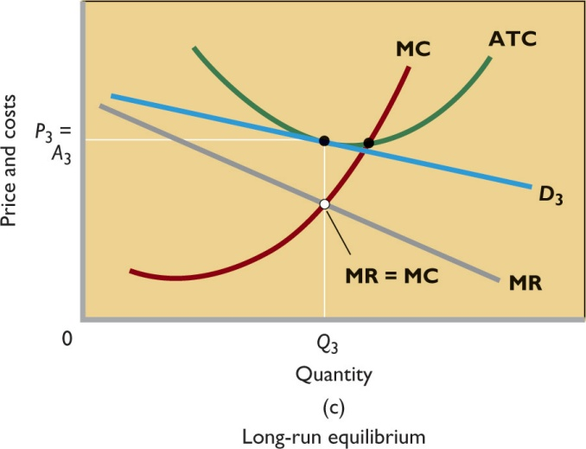
Pricing and Output in Monopolistic Competition
When the industry suffers short-run losses, some firms will exit in the long run.
As firms exit, the demand curve of surviving firms begins to shift to the right, reducing losses until the firms are just making normal profit

Slide 18
Monopolistic Competition and Efficiency
In monopolistic competition, neither productive nor allocative efficiency occurs in long-run equilibrium.
Since the firm’s profit-maximizing price (and average total cost) slightly exceed the lowest average total cost, productive efficiency is not achieved.
Since the profit-maximizing price exceeds marginal cost, monopolistic competition causes an under-allocation of resources.

Slide 19
Excess Capacity
The gap between the minimum ATC output and the profit-maximizing output is a monopolistically competitive firm’s excess capacity.
Plants and equipment are unused because the firm is producing less than the minimum- ATC output.
Monopolistically competitive industries are overcrowded with firms each operating below its optimal capacity.

Slide 20
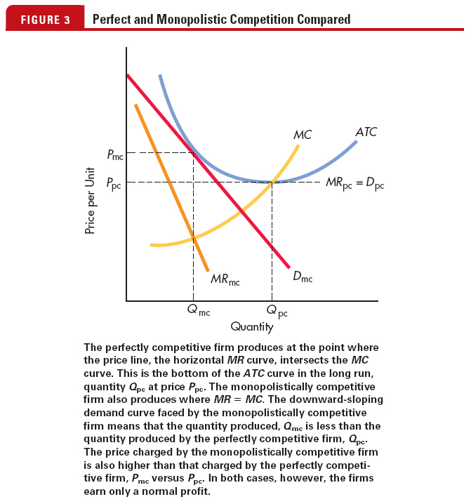
Perfect Competition and Monopolistic Competition

Slide 21
Oligopoly
Oligopoly is a market structure dominated by a few large producers of homogeneous or differentiated products.
Because of their “fewness”, Oligopolists have considerable control over their price.
Examples: tyres, beer, cigarettes, steel, copper, greeting cards, steel, aluminum, automobiles and breakfast cereals

Slide 22
Characteristics of Oligopoly
A few large producers – firms are generally large and together they dominate the industry.
Either homogeneous or differentiated products – the products are standardized, or differentiated with heaving advertising.
Price maker – the firm can set its price and output levels to maximize its profit.

Slide 23
Characteristics of Oligopoly
Strategic behavior – Self-interested behavior that takes into account the reactions of others.
Mutual interdependence – each firm’s profit depends not entirely on its own price and sales strategies but also on those of the other firms.
Blocked entry – barriers to entry exist which make it hard for new firms to enter.

Slide 24
Interdependence
When a small number of firms compete in a market, they are interdependent in the sense that the profit earned by each firm depends on the firms own actions and on the actions of the other firms.
Before making a decision, each firm must consider how the other firms will react to its decision and influence its profit.

Slide 25
Temptation to Collude
When a small number of firms share a market, they can increase their profit by forming a cartel and acting like a monopoly.
A cartel is a group of firms acting together to limit output, raise price, and increase economic profit.
Cartels are illegal but they do operate in some markets.
Despite the temptation to collude, cartels tend to collapse.

